Slide 1
Market Basket Analysis : Data Mining Technique

Slide 2
What is it?

Slide 3
What is it?
Market Basket Analysis is a modelling technique based upon the theory that if you buy a certain group of items, you are more (or less) likely to buy another group of items. For example, if you are in an English pub and you buy a pint of beer and don't buy a bar meal, you are more likely to buy crisps(chips) at the same time than somebody who didn't buy beer.
The set of items a customer buys is referred to as an itemset, and market basket analysis seeks to find relationships between purchases.
Typically the relationship will be in the form of a rule:
IF {beer, no bar meal} THEN {crisps}.
The probability that a customer will buy beer without a bar meal (i.e. that the antecedent is true) is referred to as the support for the rule. The conditional probability that a customer will purchase crisps is referred to as the confidence.

Slide 4
What is it? Continued............
The algorithms for performing market basket analysis are fairly straightforward (Berry and Linhoff is a reasonable introductory resource for this).
A major difficulty is that a large number of the rules found may be trivial for anyone familiar with the business. Although the volume of data has been reduced, we are still asking the user to find a needle in a haystack.
Requiring rules to have a high minimum support level and a high confidence level risks missing any exploitable result we might have found. One partial solution to this problem is differential market basket analysis.

Slide 5
Applications

Slide 6
Applications of Association Rules
Product recommendation – like Amazon’s
“customers who bought that, also bought this”
Music recommendations – like Last FM’s artist recommendations
Medical diagnosis – like with diabetes
Content optimisation – like in magazine websites or blogs

Slide 7
Data Preparation

Slide 8
Data Preparation
The main application of association rules is, for market basket analysis where large transaction data sets are mined. In this setting each transaction contains the items which were purchased at one visit to a retail store. Transaction data are normally recorded by point-of-sale scanners and often consists of tuples of the form:
< transaction ID, item ID, . . . >
All tuples with the same transaction ID form a single transaction which contains all the items given by the item IDs in the tuples.
Example, a customer ID might be provided via a loyalty program in a supermarket. Further information on transactions (e.g., time, location), on the items (e.g., category, price), or on the customers (socio-demographic variables such as age, gender, etc.) might also be available.

Slide 9
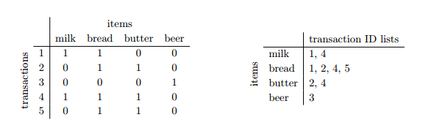
Data Preparation Continued............
For mining, the transaction data is first transformed into a binary purchase incidence matrix with columns corresponding to the different items and rows corresponding to transactions.

Slide 10
Data Preparation(in R) Continued................
In arules both layouts are implemented as the classes transactions and tidLists. Similar to transactions, class tidLists also uses a sparse representation to store its lists efficiently.
summary() to give a short overview of the set and inspect() to display individual associations,
length() for getting the number of elements in the set,
items() for getting for each association a set of items involved in the association (e.g., the union of the items in the LHS and the RHS for each rule),
sorting the set using the values of different quality measures (sort())
subset extraction ([ and subset())
set operations (union(), intersect() and sort())
matching elements from two sets (match())
write() for writing associations to disk in human readable form. To save and load associations in compact form, use save() and load() from the base package.

Slide 11
Association Rules

Slide 12
Association Rules
Association Rules find all sets of items (itemsets) that have Support greater than the minimum support and then using the large itemsets to generate the desired rules that have Confidence greater than the minimum confidence.
The Lift of a rule is the ratio of the observed support to that expected if X and Y were independent. A typical and widely used example of association rules application is market basket analysis.

Slide 13
Key Metrics
Support =
A
B
Confidence =
Lift =

Slide 14
Key Metrics(Probability) Continued............
A
Support =
B
Confidence =
Lift =

Slide 15
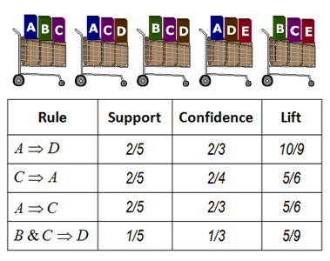
Example:

Slide 16
Metrics Interpretation
IF {beer, no bar meal} THEN {crisps}.
Support : Probability of purchase-occurrence of an ItemSet.
Confidence : Conditional probability that transaction will contain Consequent given that it includes Antecedent.
Lift/Lift Ratio : Explains how much more likely it is that Consequent is purchased as a result of purchasing Antecedent.
Antecedent
Consequent

Slide 17
Apriori Algorithm

Slide 18
Market basket analysis using apriori algorithm and arules package in R
Consider classic market basket analysis: by that It means we are going to look for rules based on actual transactions.
We’re going to use R to perform the market basket analysis. We’re going to use the Arules Package, which implements the Apriori algorithm, one of the most commonly used algorithms for identifying associations between items.

Slide 19
Groceries DataSet in R
# Apriori Recommendation with R
> library(arules)
> library(arulesViz)
> library(datasets)
# Load the data set
> data(Groceries)
# Lets explore the data before we make any rules:
# Create an item frequency plot for the top 20 items
> itemFrequencyPlot(Groceries,topN=20,type="absolute")

Slide 20
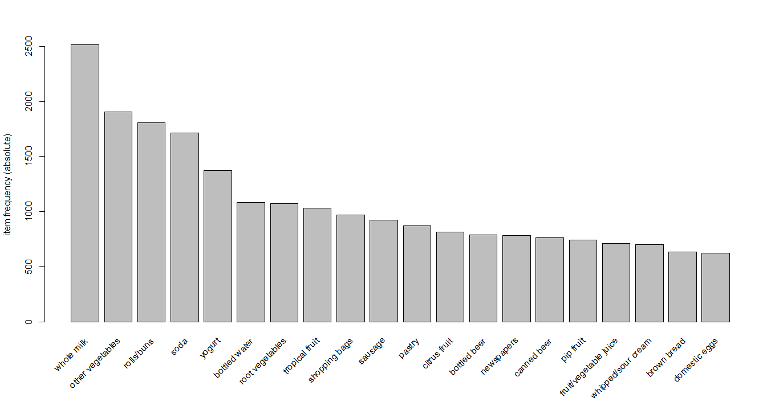
itemFrequecy Chart

Slide 21
Explore data with rules
> rules <- apriori(Groceries, parameter = list(supp = 0.001, conf = 0.8))
Lhs | Rhs | Support | Confidence | Lift
{liquor, red/blush wine} | => {bottled beer} | 0.0019 | 0.90 | 11.2
{curd, cereals} | => {whole milk} | 0.0010 | 0.91 | 3.6
{yogurt, cereals} | => {whole milk} | 0.0017 | 0.81 | 3.2
{butter, jam} | => {whole milk} | 0.0010 | 0.83 | 3.3
{soups, bottled beer} | => {whole milk} | 0.0011 | 0.92 | 3.6

Slide 22
Summary of rules
set of 410 rules
rule length distribution (lhs + rhs): sizes
3 4 5 6
29 229 140 12
summary of quality measures:
support conf. lift
Min. :0.00102 Min. :0.80 Min. : 3.1
1st Qu.:0.00102 1st Qu.:0.83 1st Qu.: 3.3
mining info:
data n support confidence
Groceries 9835 0.001 0.8

Slide 23
Sort rules according to Confidence
Lhs | Rhs | Support | Confidence | Lift
{rice, sugar} | => {whole milk} | 0.0012 | 1 | 11.2
{canned fish, hygiene articles} | => {whole milk} | 0.0011 | 1 | 3.6
{root vegetables, butter, rice} | => {whole milk} | 0.0010 | 1 | 3.2
{root vegetables, whipped/sour cream, flour} | => {whole milk} | 0.0017 | 1 | 3.3
{butter, soft cheese, domestic eggs} | => {whole milk} | 0.0010 | 1 | 3.6

Slide 24
Remove Duplicate Rules
Sometimes, rules will repeat. Redundancy indicates that one item might be a given. Alternatively, we can remove redundant rules generated.
Targeting Items
There are two types of targets we might be interested in that are illustrated with an example of “whole milk”:
What are customers likely to buy before buying whole milk?
What are customers likely to buy if they purchase whole milk?

Slide 25
Targeting Items What are customers likely to buy before buying whole milk
Lhs | Rhs | Support | Confidence | Lift
{rice, sugar} | => {whole milk} | 0.0012 | 1 | 11.2
{canned fish, hygiene articles} | => {whole milk} | 0.0011 | 1 | 3.6
{root vegetables, butter, rice} | => {whole milk} | 0.0010 | 1 | 3.2
{root vegetables, whipped/sour cream, flour} | => {whole milk} | 0.0017 | 1 | 3.3
{butter, soft cheese, domestic eggs} | => {whole milk} | 0.0010 | 1 | 3.6

Slide 26
Targeting Items What are customers likely to buy if they purchase whole milk?
Lhs | Rhs | Support | Confidence | Lift
{whole milk} | => {other vegetables} | 0.075 | 0.29 | 1.5
{whole milk} | => {rolls/buns} | 0.057 | 0.22 | 1.2
{whole milk} | => {yogurt} | 0.056 | 0.22 | 1.6
{whole milk} | => {root vegetables} | 0.049 | 0.19 | 1.8
{whole milk} | => {tropical fruit} | 0.042 | 0.17 | 1.6
{whole milk} | => {soda} | 0.040 | 0.16 | 0.9

Slide 27
Challenges

Slide 28
Challenges
We should be looking for those association rules which tell us that it is far more likely that two items X and Y are purchased together than item Y being purchased by itself.
We must be careful to start with choosing itemsets which have a certain minimum level of Support. In other words, we must choose itemsets which meet a minimum sales threshold. But what is this minimum support?
Often a simple percentage may be sufficient. For example, if we have a database of 2000 transactions, we can set a 10% support threshold. This would filter out any itemsets which have less than 200 transactions.

Slide 29
Challenges Continued................
In a database of millions of point of sale (POS) transactions, if we find that an itemset has fewer than a dozen entries, then the support is very low. But what if the dollar value of the transaction is very high? Then this transaction will be of significance, so discarding this itemset because of low support would not be a good idea.
If we are not careful about how we cull these association rules we may lose some valuable information.

Slide 30
Appendix

